Slide 1
CS 300- Operating Systems Process Management

Slide 2
Process Concept
An operating system executes a variety of programs:
Batch system – jobs
Time-shared systems – user programs or tasks
Process – a program in execution; process execution must progress in sequential fashion
Multiple parts
The program code, also called text section
Current activity including program counter, processor registers
Stack containing temporary data
Function parameters, return addresses, local variables
Data section containing global variables
Heap containing memory dynamically allocated during run time

Slide 3
Process Concept (Cont.)
Program is passive entity stored on disk (executable file), process is active
Program becomes process when executable file loaded into memory
Execution of program started via GUI mouse clicks, command line entry of its name, etc
One program can be several processes
Consider multiple users executing the same program

Slide 4
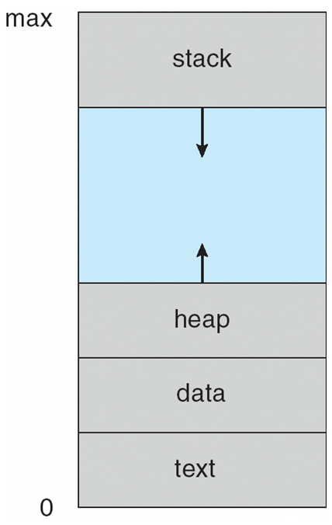
Process in Memory

Slide 5
Process State
As a process executes, it changes state
new: The process is being created
running: Instructions are being executed
waiting: The process is waiting for some event to occur
ready: The process is waiting to be assigned to a processor
terminated: The process has finished execution

Slide 6
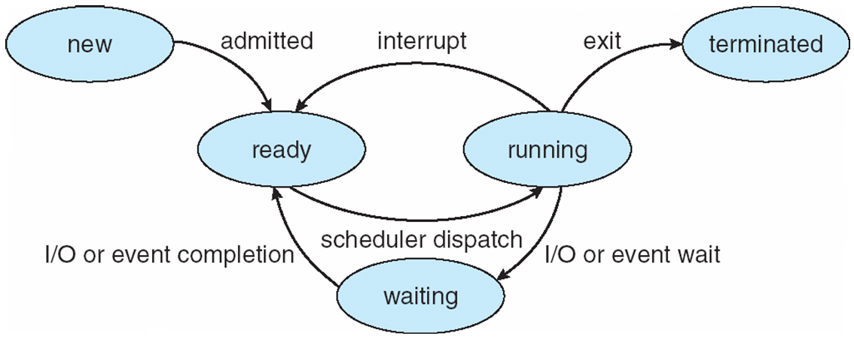
Diagram of Process State

Slide 7
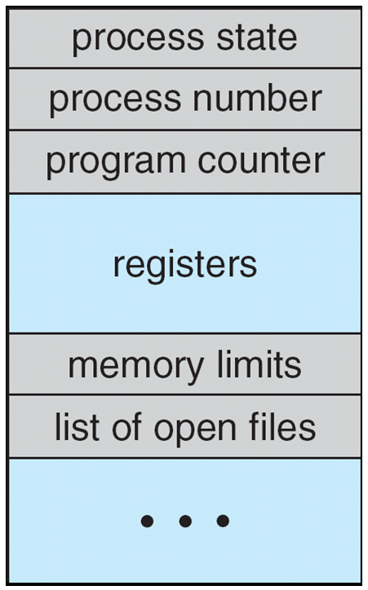
Process Control Block (PCB)
Information associated with each process
(also called task control block)
Process state – running, waiting, etc
Program counter – location of instruction to next execute
CPU registers – contents of all process-centric registers
CPU scheduling information- priorities, scheduling queue pointers
Memory-management information – memory allocated to the process
Accounting information – CPU used, clock time elapsed since start, time limits
I/O status information – I/O devices allocated to process, list of open files

Slide 8
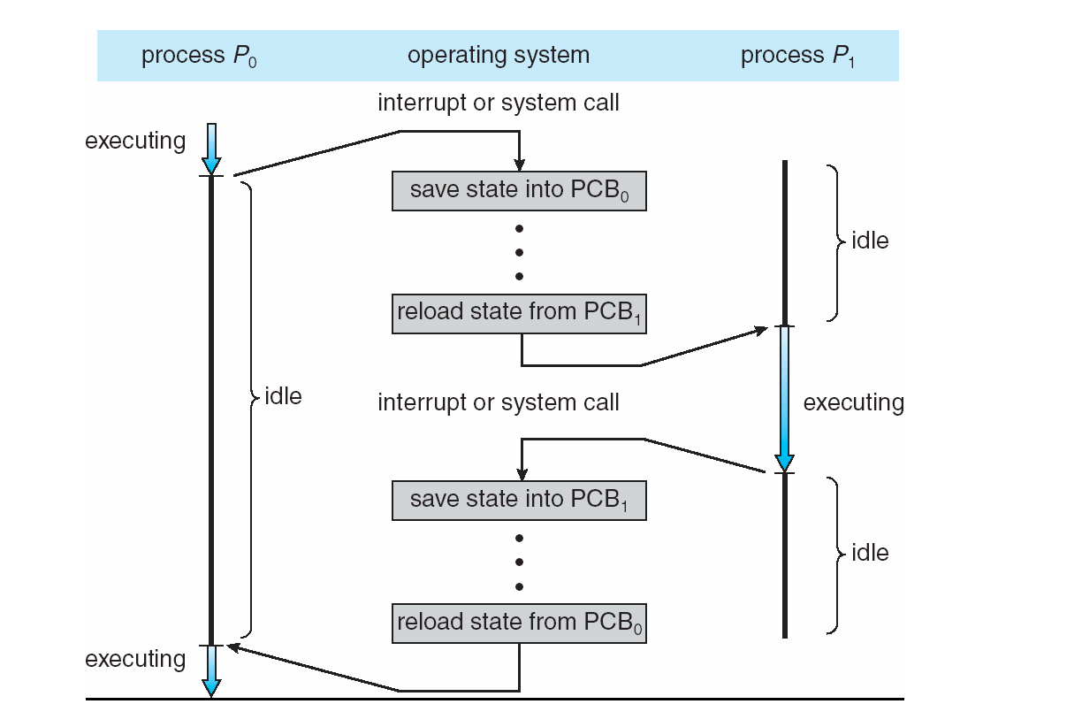
CPU Switch From Process to Process

Slide 9
Threads
So far, process has a single thread of execution
Consider having multiple program counters per process
Multiple locations can execute at once
Multiple threads of control -> threads
Must then have storage for thread details, multiple program counters in PCB

Slide 10
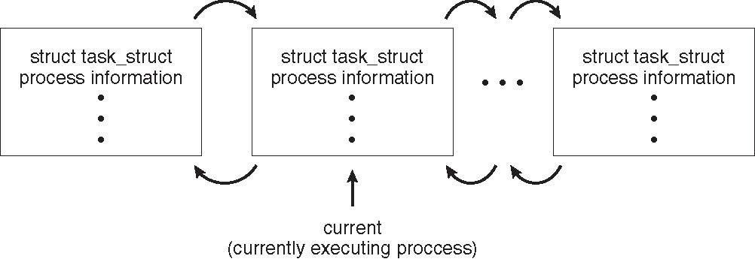
Process Representation in Linux
Represented by the C structure task_struct
pid t_pid; /* process identifier */ long state; /* state of the process */ unsigned int time_slice /* scheduling information */ struct task_struct *parent; /* this process’s parent */ struct list_head children; /* this process’s children */ struct files_struct *files; /* list of open files */ struct mm_struct *mm; /* address space of this process */

Slide 11
Process Scheduling
Maximize CPU use, quickly switch processes onto CPU for time sharing
Process scheduler selects among available processes for next execution on CPU
Maintains scheduling queues of processes
Job queue – set of all processes in the system
Ready queue – set of all processes residing in main memory, ready and waiting to execute
Device queues – set of processes waiting for an I/O device
Processes migrate among the various queues

Slide 12
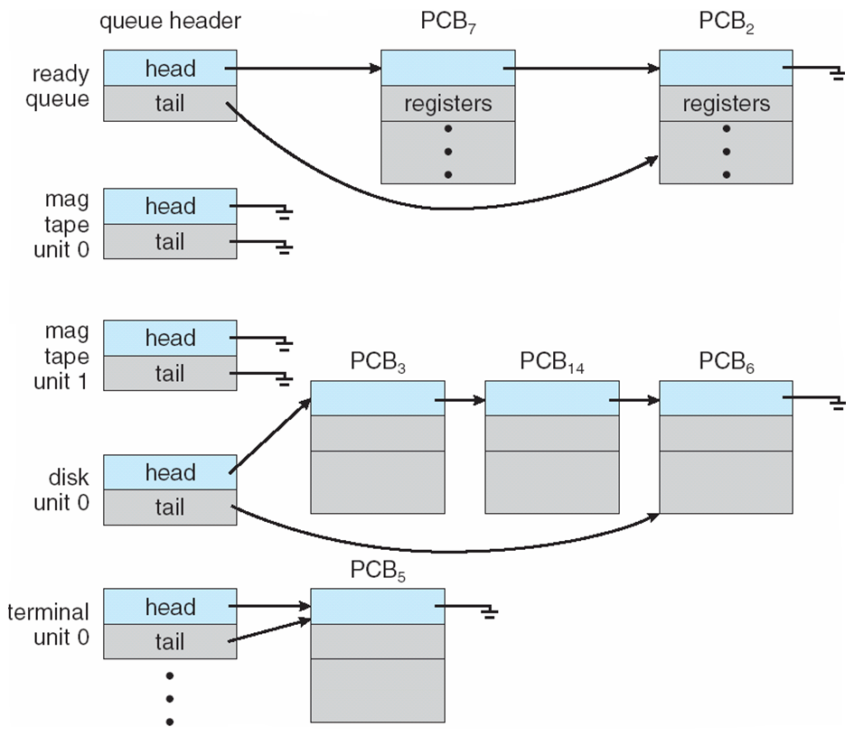
Ready Queue And Various I/O Device Queues

Slide 13
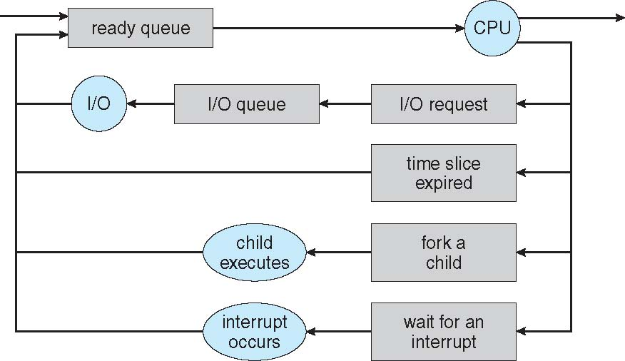
Representation of Process Scheduling
Queueing diagram represents queues, resources, flows

Slide 14
Schedulers
Short-term scheduler (or CPU scheduler) – selects which process should be executed next and allocates CPU
Sometimes the only scheduler in a system
Short-term scheduler is invoked frequently (milliseconds) ⇒ (must be fast)
Long-term scheduler (or job scheduler) – selects which processes should be brought into the ready queue
Long-term scheduler is invoked infrequently (seconds, minutes) ⇒ (may be slow)
The long-term scheduler controls the degree of multiprogramming
Processes can be described as either:
I/O-bound process – spends more time doing I/O than computations, many short CPU bursts
CPU-bound process – spends more time doing computations; few very long CPU bursts
Long-term scheduler strives for good process mix

Slide 15
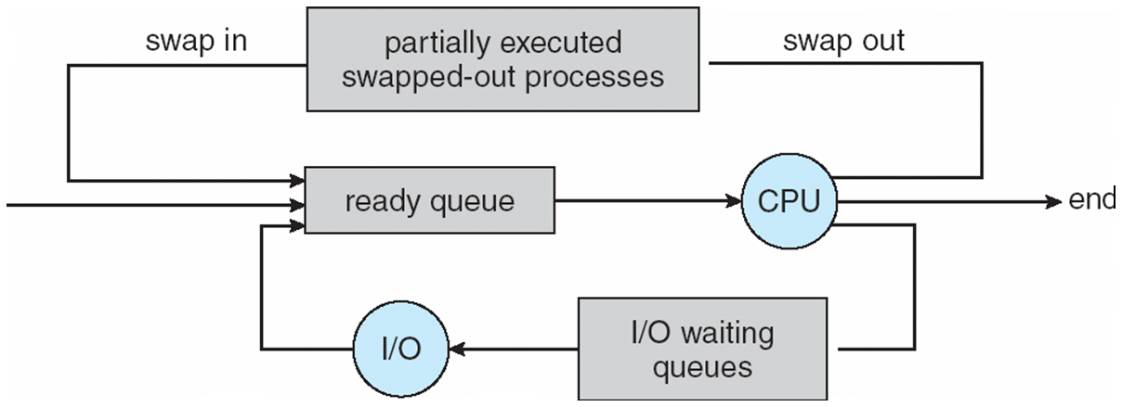
Addition of Medium Term Scheduling
Medium-term scheduler can be added if degree of multiple programming needs to decrease
Remove process from memory, store on disk, bring back in from disk to continue execution: swapping

Slide 16
Context Switch
When CPU switches to another process, the system must save the state of the old process and load the saved state for the new process via a context switch
Context of a process represented in the PCB
Context-switch time is overhead; the system does no useful work while switching
The more complex the OS and the PCB ➔ the longer the context switch
Time dependent on hardware support
Some hardware provides multiple sets of registers per CPU ➔ multiple contexts loaded at once

Slide 17
Operations on Processes
System must provide mechanisms for:
process creation,
process termination,
and so on

Slide 18
Process Creation
Parent process create children processes, which, in turn create other processes, forming a tree of processes
Generally, process identified and managed via a process identifier (pid)
Resource sharing options
Parent and children share all resources
Children share subset of parent’s resources
Parent and child share no resources
Execution options
Parent and children execute concurrently
Parent waits until children terminate

Slide 19
A Tree of Processes in Linux

Slide 20
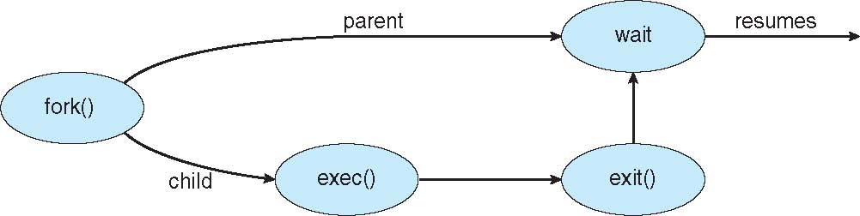
Process Creation (Cont.)
Address space
Child duplicate of parent
Child has a program loaded into it
UNIX examples
fork() system call creates new process
exec() system call used after a fork() to replace the process’ memory space with a new program

Slide 21
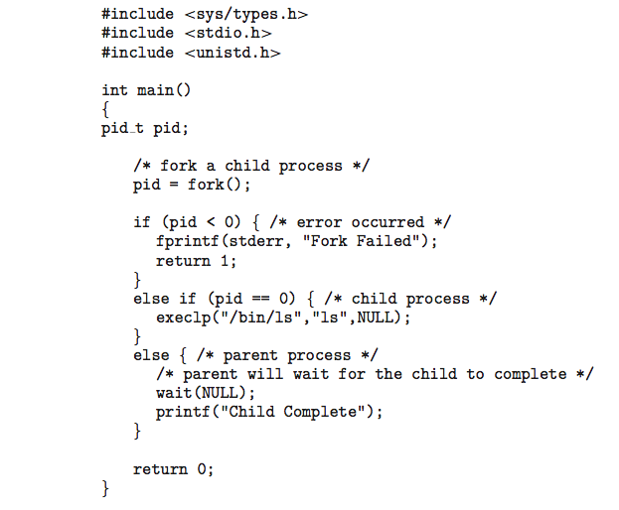
C Program Forking Separate Process

Slide 22
Process Termination
Process executes last statement and then asks the operating system to delete it using the exit() system call.
Returns status data from child to parent (via wait())
Process’ resources are deallocated by operating system
Parent may terminate the execution of children processes using the abort() system call. Some reasons for doing so:
Child has exceeded allocated resources
Task assigned to child is no longer required
The parent is exiting and the operating systems does not allow a child to continue if its parent terminates

Slide 23
Process Termination
Some operating systems do not allow child to exists if its parent has terminated. If a process terminates, then all its children must also be terminated.
cascading termination. All children, grandchildren, etc. are terminated.
The termination is initiated by the operating system.
The parent process may wait for termination of a child process by using the wait()system call. The call returns status information and the pid of the terminated process
pid = wait(&status);
If no parent waiting (did not invoke wait()) process is a zombie
If parent terminated without invoking wait , process is an orphan

Slide 24

Multiprocess Architecture – Chrome Browser
Many web browsers ran as single process (some still do)
If one web site causes trouble, entire browser can hang or crash
Google Chrome Browser is multiprocess with 3 different types of processes:
Browser process manages user interface, disk and network I/O
Renderer process renders web pages, deals with HTML, Javascript. A new renderer created for each website opened
Runs in sandbox restricting disk and network I/O, minimizing effect of security exploits
Plug-in process for each type of plug-in

Slide 25
Interprocess Communication
Processes within a system may be independent or cooperating
Cooperating process can affect or be affected by other processes, including sharing data
Reasons for cooperating processes:
Information sharing
Computation speedup
Modularity
Convenience
Cooperating processes need interprocess communication (IPC)
Two models of IPC
Shared memory
Message passing

Slide 26
Communications Models
(a) Message passing. (b) shared memory.

Slide 27
Cooperating Processes
Independent process cannot affect or be affected by the execution of another process
Cooperating process can affect or be affected by the execution of another process
Advantages of process cooperation
Information sharing
Computation speed-up
Modularity
Convenience

Slide 28
Producer-Consumer Problem
Paradigm for cooperating processes, producer process produces information that is consumed by a consumer process
unbounded-buffer places no practical limit on the size of the buffer
bounded-buffer assumes that there is a fixed buffer size

Slide 29
Bounded-Buffer – Shared-Memory Solution
Shared data
#define BUFFER_SIZE 10
typedef struct {
. . .
} item;
item buffer[BUFFER_SIZE];
int in = 0;
int out = 0;
Solution is correct, but can only use BUFFER_SIZE-1 elements

Slide 30
Bounded-Buffer – Producer
item next_produced;
while (true) {
/* produce an item in next produced */
while (((in + 1) % BUFFER_SIZE) == out)
; /* do nothing */
buffer[in] = next_produced;
in = (in + 1) % BUFFER_SIZE;
}

Slide 31
Bounded Buffer – Consumer
item next_consumed;
while (true) { while (in == out)
; /* do nothing */ next_consumed = buffer[out];
out = (out + 1) % BUFFER_SIZE;
/* consume the item in next consumed */
}

Slide 32
Interprocess Communication – Shared Memory
An area of memory shared among the processes that wish to communicate
The communication is under the control of the users processes not the operating system.
Major issues is to provide mechanism that will allow the user processes to synchronize their actions when they access shared memory.

Slide 33
Interprocess Communication – Message Passing
Mechanism for processes to communicate and to synchronize their actions
Message system – processes communicate with each other without resorting to shared variables
IPC facility provides two operations:
send(message)
receive(message)
The message size is either fixed or variable

Slide 34
Message Passing (Cont.)
If processes P and Q wish to communicate, they need to:
Establish a communication link between them
Exchange messages via send/receive
Implementation issues:
How are links established?
Can a link be associated with more than two processes?
How many links can there be between every pair of communicating processes?
What is the capacity of a link?
Is the size of a message that the link can accommodate fixed or variable?
Is a link unidirectional or bi-directional?

Slide 35
Message Passing (Cont.)
Implementation of communication link
Physical:
Shared memory
Hardware bus
Network
Logical:
Direct or indirect
Synchronous or asynchronous
Automatic or explicit buffering

Slide 36
Direct Communication
Processes must name each other explicitly:
send (P, message) – send a message to process P
receive(Q, message) – receive a message from process Q
Properties of communication link
Links are established automatically
A link is associated with exactly one pair of communicating processes
Between each pair there exists exactly one link
The link may be unidirectional, but is usually bi-directional

Slide 37
Indirect Communication
Messages are directed and received from mailboxes (also referred to as ports)
Each mailbox has a unique id
Processes can communicate only if they share a mailbox
Properties of communication link
Link established only if processes share a common mailbox
A link may be associated with many processes
Each pair of processes may share several communication links
Link may be unidirectional or bi-directional

Slide 38
Indirect Communication
Operations
create a new mailbox (port)
send and receive messages through mailbox
destroy a mailbox
Primitives are defined as:
send(A, message) – send a message to mailbox A
receive(A, message) – receive a message from mailbox A

Slide 39
Indirect Communication
Mailbox sharing
P₁, P₂, and P₃ share mailbox A
P₁, sends; P₂ and P₃ receive
Who gets the message?
Solutions
Allow a link to be associated with at most two processes
Allow only one process at a time to execute a receive operation
Allow the system to select arbitrarily the receiver. Sender is notified who the receiver was.

Slide 40
Synchronization
Message passing may be either blocking or non-blocking
Blocking is considered synchronous
Blocking send -- the sender is blocked until the message is received
Blocking receive -- the receiver is blocked until a message is available
Non-blocking is considered asynchronous
Non-blocking send -- the sender sends the message and continue
Non-blocking receive -- the receiver receives:
A valid message, or
Null message
Different combinations possible
If both send and receive are blocking, we have a rendezvous

Slide 41
Synchronization (Cont.)
Producer-consumer becomes trivial
message next_produced;
while (true) { /* produce an item in next produced */
send(next_produced);
}
message next_consumed;
while (true) {
receive(next_consumed);
/* consume the item in next consumed */
}

Slide 42
Buffering
Queue of messages attached to the link.
implemented in one of three ways
1. Zero capacity – no messages are queued on a link. Sender must wait for receiver (rendezvous)
2. Bounded capacity – finite length of n messages. Sender must wait if link full
3. Unbounded capacity – infinite length Sender never waits

Slide 43
Communications in Client-Server Systems
Sockets
Remote Procedure Calls
Pipes
Remote Method Invocation (Java)

Slide 44
Sockets
A socket is defined as an endpoint for communication
Concatenation of IP address and port – a number included at start of message packet to differentiate network services on a host
The socket 161.25.19.8:1625 refers to port 1625 on host 161.25.19.8
Communication consists between a pair of sockets
All ports below 1024 are well known, used for standard services
Special IP address 127.0.0.1 (loopback) to refer to system on which process is running

Slide 45
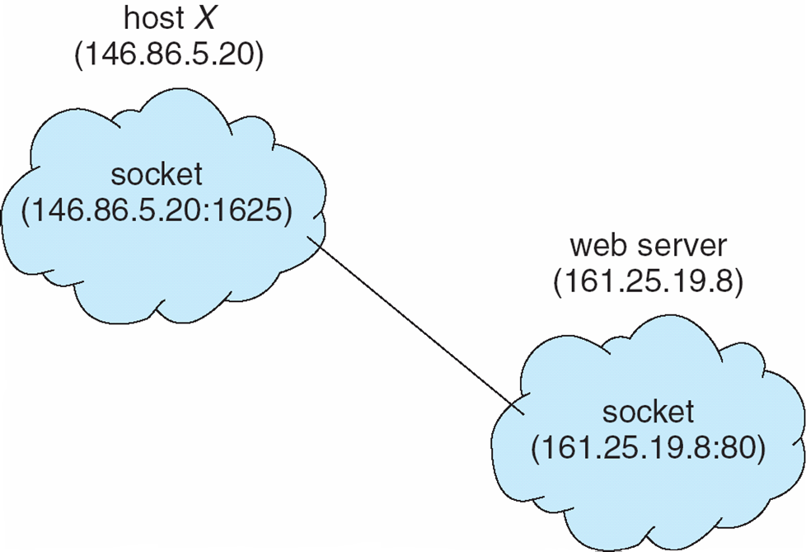
Socket Communication

Slide 46
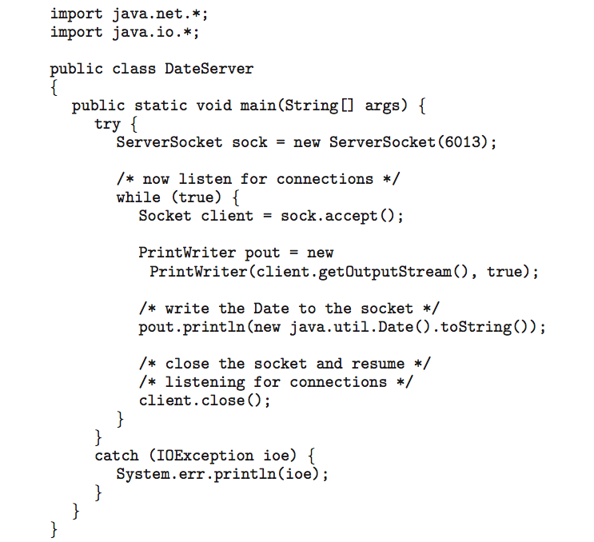
Sockets in Java
Three types of sockets
Connection-oriented (TCP)
Connectionless (UDP)
MulticastSocket class– data can be sent to multiple recipients
Consider this “Date” server:

Slide 47
Remote Procedure Calls
Remote procedure call (RPC) abstracts procedure calls between processes on networked systems
Again uses ports for service differentiation
Stubs – client-side proxy for the actual procedure on the server
The client-side stub locates the server and marshalls the parameters
The server-side stub receives this message, unpacks the marshalled parameters, and performs the procedure on the server
On Windows, stub code compile from specification written in Microsoft Interface Definition Language (MIDL)

Slide 48
Pipes
Acts as a conduit allowing two processes to communicate
Issues:
Is communication unidirectional or bidirectional?
In the case of two-way communication, is it half or full-duplex?
Must there exist a relationship (i.e., parent-child) between the communicating processes?
Can the pipes be used over a network?
Ordinary pipes – cannot be accessed from outside the process that created it. Typically, a parent process creates a pipe and uses it to communicate with a child process that it created.
Named pipes – can be accessed without a parent-child relationship.

Slide 49
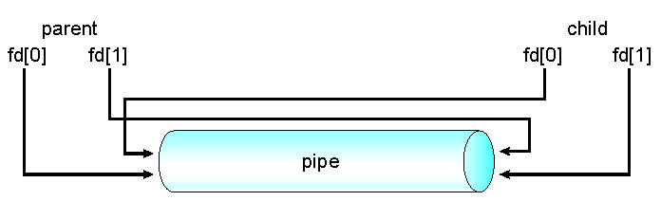
Ordinary Pipes
Ordinary Pipes allow communication in standard producer-consumer style
Producer writes to one end (the write-end of the pipe)
Consumer reads from the other end (the read-end of the pipe)
Ordinary pipes are therefore unidirectional
Require parent-child relationship between communicating processes
Windows calls these anonymous pipes

Slide 50
Named Pipes
Named Pipes are more powerful than ordinary pipes
Communication is bidirectional
No parent-child relationship is necessary between the communicating processes
Several processes can use the named pipe for communication
Provided on both UNIX and Windows systems

Slide 51
Multithreaded Server Architecture

Slide 52
Benefits
Responsiveness – may allow continued execution if part of process is blocked, especially important for user interfaces
Resource Sharing – threads share resources of process, easier than shared memory or message passing
Economy – cheaper than process creation, thread switching lower overhead than context switching
Scalability – process can take advantage of multiprocessor architectures

Slide 53
Multicore Programming
Multicore or multiprocessor systems putting pressure on programmers, challenges include:
Dividing activities
Balance
Data splitting
Data dependency
Testing and debugging
Parallelism implies a system can perform more than one task simultaneously
Concurrency supports more than one task making progress
Single processor / core, scheduler providing concurrency

Slide 54
Multicore Programming (Cont.)
Types of parallelism
Data parallelism – distributes subsets of the same data across multiple cores, same operation on each
Task parallelism – distributing threads across cores, each thread performing unique operation
As # of threads grows, so does architectural support for threading
CPUs have cores as well as hardware threads
Consider Oracle SPARC T4 with 8 cores, and 8 hardware threads per core

Slide 55
Concurrency vs. Parallelism
Concurrent execution on single-core system:
Parallelism on a multi-core system:

Slide 56
Single and Multithreaded Processes

Slide 57
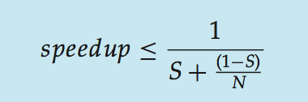
Amdahl’s Law
Identifies performance gains from adding additional cores to an application that has both serial and parallel components
S is serial portion
N processing cores
That is, if application is 75% parallel / 25% serial, moving from 1 to 2 cores results in speedup of 1.6 times
As N approaches infinity, speedup approaches 1 / S
Serial portion of an application has disproportionate effect on performance gained by adding additional cores

Slide 58
User Threads and Kernel Threads
User threads - management done by user-level threads library
Three primary thread libraries:
POSIX Pthreads
Windows threads
Java threads
Kernel threads - Supported by the Kernel
Examples – virtually all general purpose operating systems, including:
Windows
Solaris
Linux
Tru64 UNIX
Mac OS X

Slide 59
Multithreading Models
Many-to-One
One-to-One
Many-to-Many

Slide 60
Many-to-One
Many user-level threads mapped to single kernel thread
One thread blocking causes all to block
Multiple threads may not run in parallel on muticore system because only one may be in kernel at a time
Few systems currently use this model
Examples:
Solaris Green Threads
GNU Portable Threads

Slide 61
One-to-One
Each user-level thread maps to kernel thread
Creating a user-level thread creates a kernel thread
More concurrency than many-to-one
Number of threads per process sometimes restricted due to overhead
Examples
Windows
Linux
Solaris 9 and later

Slide 62
Many-to-Many Model
Allows many user level threads to be mapped to many kernel threads
Allows the operating system to create a sufficient number of kernel threads
Solaris prior to version 9
Windows with the ThreadFiber package

Slide 63
Two-level Model
Similar to M:M, except that it allows a user thread to be bound to kernel thread
Examples
IRIX
HP-UX
Tru64 UNIX
Solaris 8 and earlier

Slide 64
Thread Libraries
Thread library provides programmer with API for creating and managing threads
Two primary ways of implementing
Library entirely in user space
Kernel-level library supported by the OS

Slide 65
Pthreads
May be provided either as user-level or kernel-level
A POSIX standard (IEEE 1003.1c) API for thread creation and synchronization
Specification, not implementation
API specifies behavior of the thread library, implementation is up to development of the library
Common in UNIX operating systems (Solaris, Linux, Mac OS X)

Slide 66
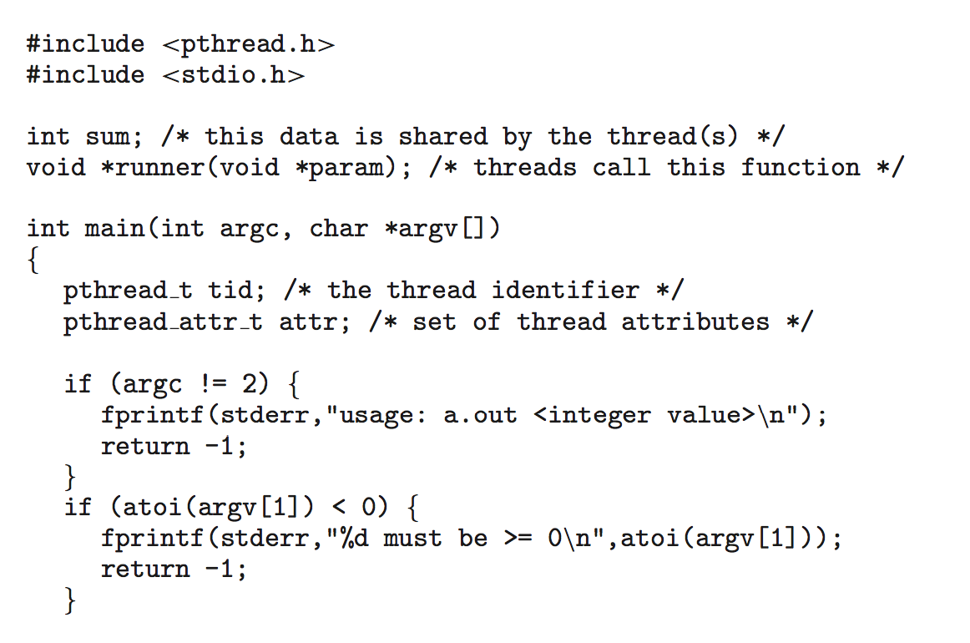
Pthreads Example

Slide 67
Pthreads Example (Cont.)

Slide 68
Pthreads Code for Joining 10 Threads

Slide 69
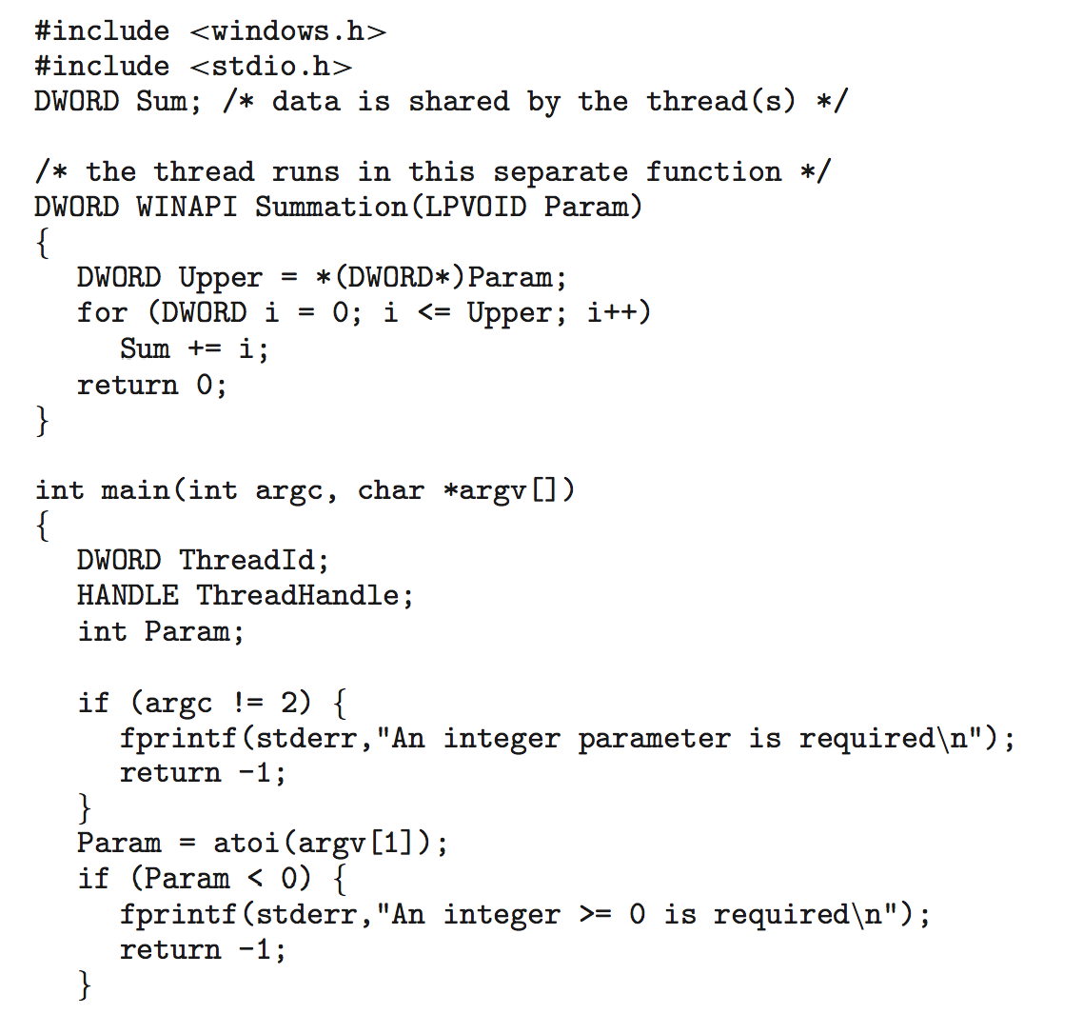
Windows Multithreaded C Program

Slide 70
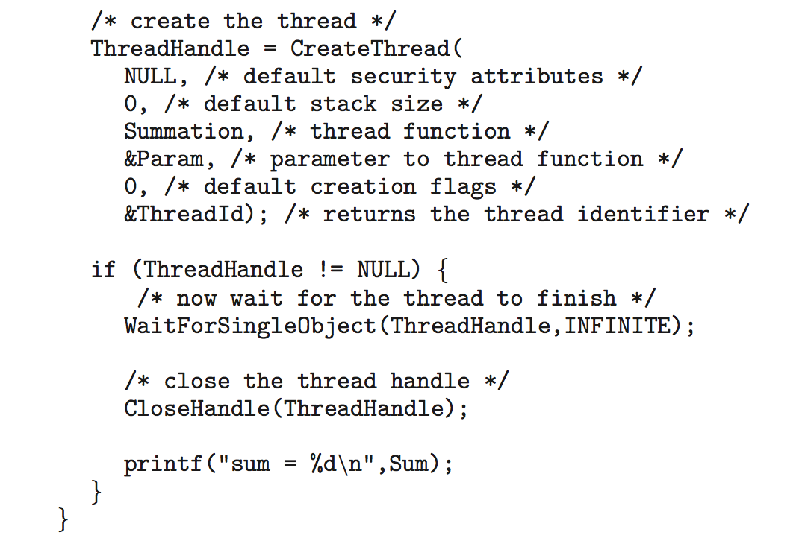
Windows Multithreaded C Program (Cont.)

Slide 71
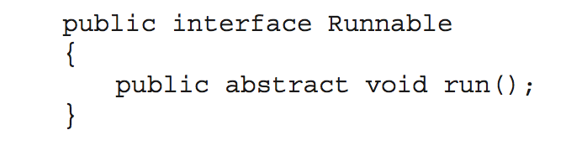
Java Threads
Java threads are managed by the JVM
Typically implemented using the threads model provided by underlying OS
Java threads may be created by:
Extending Thread class
Implementing the Runnable interface

Slide 72
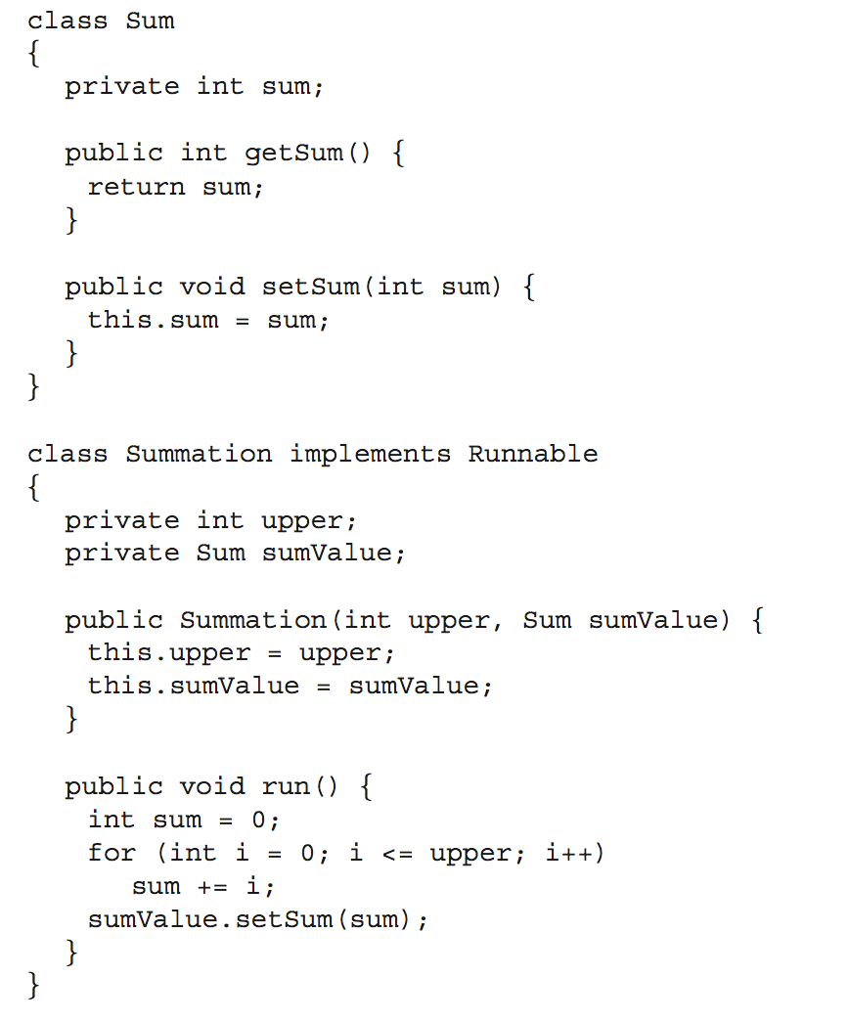
Java Multithreaded Program

Slide 73
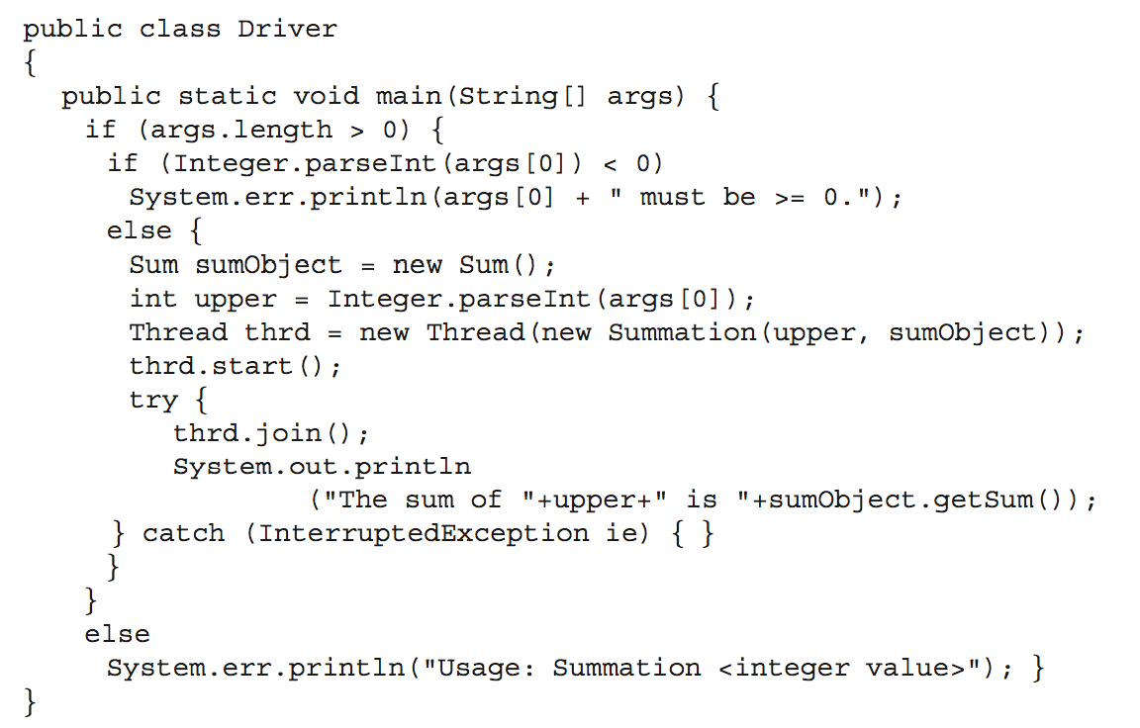
Java Multithreaded Program (Cont.)

Slide 74
Implicit Threading
Growing in popularity as numbers of threads increase, program correctness more difficult with explicit threads
Creation and management of threads done by compilers and run-time libraries rather than programmers
Three methods explored
Thread Pools
OpenMP
Grand Central Dispatch
Other methods include Microsoft Threading Building Blocks (TBB), java.util.concurrent package

Slide 75
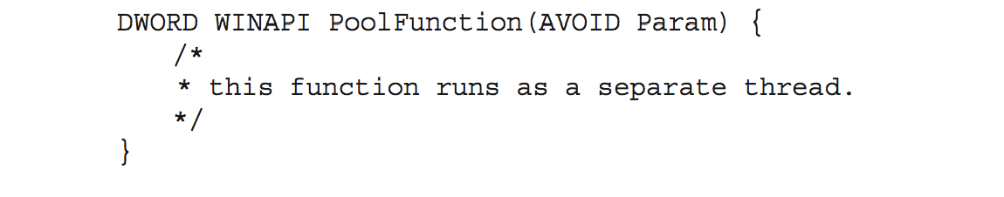
Thread Pools
Create a number of threads in a pool where they await work
Advantages:
Usually slightly faster to service a request with an existing thread than create a new thread
Allows the number of threads in the application(s) to be bound to the size of the pool
Separating task to be performed from mechanics of creating task allows different strategies for running task
i.e.Tasks could be scheduled to run periodically
Windows API supports thread pools:

Slide 76
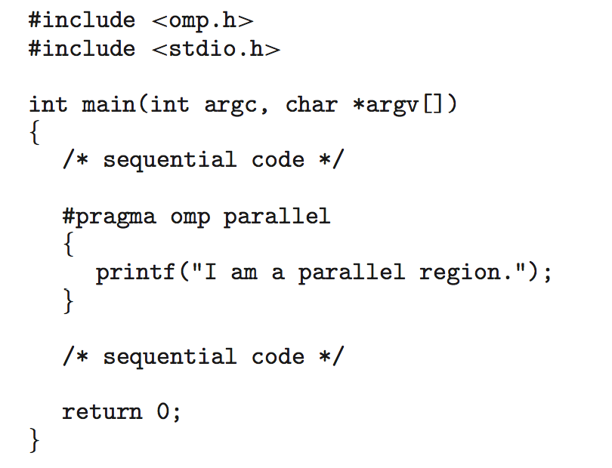
OpenMP
Set of compiler directives and an API for C, C++, FORTRAN
Provides support for parallel programming in shared-memory environments
Identifies parallel regions – blocks of code that can run in parallel
#pragma omp parallel
Create as many threads as there are cores
#pragma omp parallel for for(i=0;i<N;i++) {
c[i] = a[i] + b[i];
}
Run for loop in parallel

Slide 77
Grand Central Dispatch
Apple technology for Mac OS X and iOS operating systems
Extensions to C, C++ languages, API, and run-time library
Allows identification of parallel sections
Manages most of the details of threading
Block is in “^{ }” - ˆ{ printf("I am a block"); }
Blocks placed in dispatch queue
Assigned to available thread in thread pool when removed from queue

Slide 78
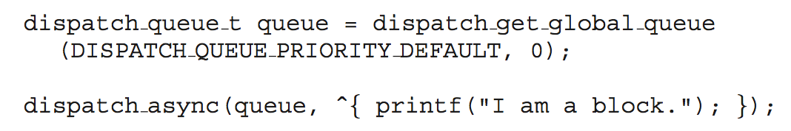
Grand Central Dispatch
Two types of dispatch queues:
serial – blocks removed in FIFO order, queue is per process, called main queue
Programmers can create additional serial queues within program
concurrent – removed in FIFO order but several may be removed at a time
Three system wide queues with priorities low, default, high

Slide 79
Threading Issues
Semantics of fork() and exec() system calls
Signal handling
Synchronous (in process) and asynchronous (external)
Thread cancellation of target thread
Asynchronous or deferred
Thread-local storage
Scheduler Activations

Slide 80
Semantics of fork() and exec()
Does fork()duplicate only the calling thread or all threads?
Some UNIXes have two versions of fork
exec() usually works as normal – replace the running process including all threads

Slide 81
Signal Handling
Signals are used in UNIX systems to notify a process that a particular event has occurred.
A signal handler is used to process signals
Signal is generated by particular event
Signal is delivered to a process
Signal is handled by one of two signal handlers:
default
user-defined
Every signal has default handler that kernel runs when handling signal
User-defined signal handler can override default
For single-threaded, signal delivered to process

Slide 82
Signal Handling (Cont.)
Where should a signal be delivered for multi-threaded?
Deliver the signal to the thread to which the signal applies
Deliver the signal to every thread in the process
Deliver the signal to certain threads in the process
Assign a specific thread to receive all signals for the process

Slide 83
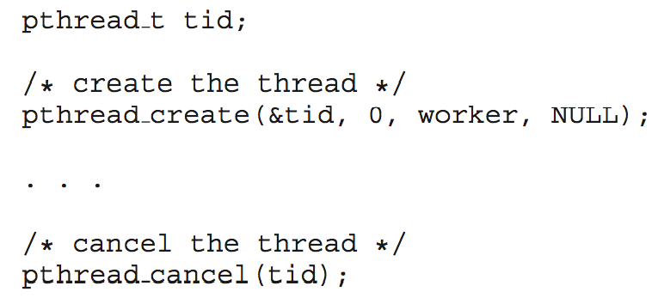
Thread Cancellation
Terminating a thread before it has finished
Thread to be canceled is target thread
Two general approaches:
Asynchronous cancellation terminates the target thread immediately
Deferred cancellation allows the target thread to periodically check if it should be cancelled
Pthread code to create and cancel a thread:

Slide 84
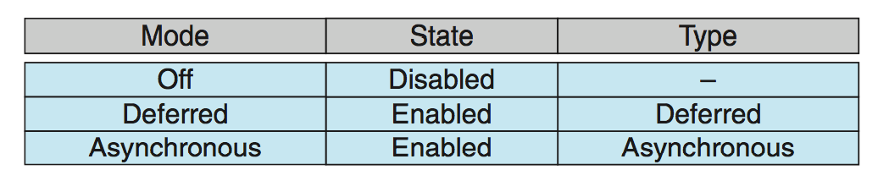
Thread Cancellation (Cont.)
Invoking thread cancellation requests cancellation, but actual cancellation depends on thread state
If thread has cancellation disabled, cancellation remains pending until thread enables it
Default type is deferred
Cancellation only occurs when thread reaches cancellation point
I.e. pthread_testcancel()
Then cleanup handler is invoked
On Linux systems, thread cancellation is handled through signals

Slide 85
Thread-Local Storage
Thread-local storage (TLS) allows each thread to have its own copy of data
Useful when you do not have control over the thread creation process (i.e., when using a thread pool)
Different from local variables
Local variables visible only during single function invocation
TLS visible across function invocations
Similar to static data
TLS is unique to each thread

Slide 86
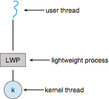
Scheduler Activations
Both M:M and Two-level models require communication to maintain the appropriate number of kernel threads allocated to the application
Typically use an intermediate data structure between user and kernel threads – lightweight process (LWP)
Appears to be a virtual processor on which process can schedule user thread to run
Each LWP attached to kernel thread
Scheduler activations provide upcalls - a communication mechanism from the kernel to the upcall handler in the thread library
This communication allows an application to maintain the correct number kernel threads

Slide 87
Process Synchronization
Processes can execute concurrently
May be interrupted at any time, partially completing execution
Concurrent access to shared data may result in data inconsistency
Maintaining data consistency requires mechanisms to ensure the orderly execution of cooperating processes
Illustration of the problem: Suppose that we wanted to provide a solution to the consumer-producer problem that fills all the buffers. We can do so by having an integer counter that keeps track of the number of full buffers. Initially, counter is set to 0. It is incremented by the producer after it produces a new buffer and is decremented by the consumer after it consumes a buffer.

Slide 88
Producer
while (true) { /* produce an item in next produced */
while (counter == BUFFER_SIZE) ;
/* do nothing */
buffer[in] = next_produced;
in = (in + 1) % BUFFER_SIZE;
counter++;
}

Slide 89
Consumer
while (true) {
while (counter == 0)
; /* do nothing */
next_consumed = buffer[out];
out = (out + 1) % BUFFER_SIZE;
counter--;
/* consume the item in next consumed */
}

Slide 90
Race Condition
counter++ could be implemented as register1 = counter register1 = register1 + 1 counter = register1
counter-- could be implemented as register2 = counter register2 = register2 - 1 counter = register2
Consider this execution interleaving with “count = 5” initially:
S0: producer execute register1 = counter {register1 = 5} S1: producer execute register1 = register1 + 1 {register1 = 6} S2: consumer execute register2 = counter {register2 = 5} S3: consumer execute register2 = register2 – 1 {register2 = 4} S4: producer execute counter = register1 {counter = 6 } S5: consumer execute counter = register2 {counter = 4}

Slide 91
Critical Section Problem
Consider system of n processes {p₀, p₁, … p_{n-1}}
Each process has critical section segment of code
Process may be changing common variables, updating table, writing file, etc
When one process in critical section, no other may be in its critical section
Critical section problem is to design protocol to solve this
Each process must ask permission to enter critical section in entry section, may follow critical section with exit section, then remainder section

Slide 92
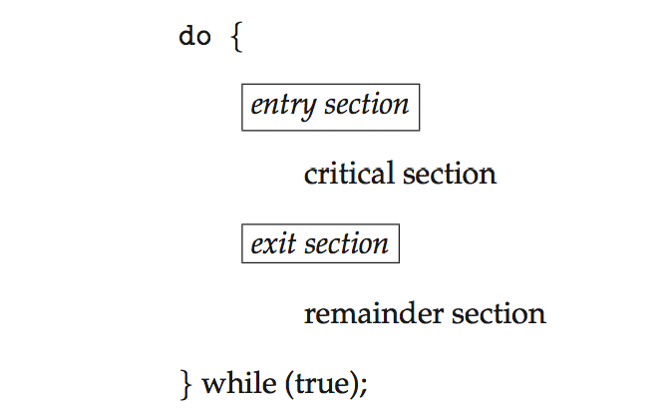
Critical Section
General structure of process P_{i}

Slide 93
Algorithm for Process P_{i}
do {
while (turn == j);
critical section
turn = j;
remainder section
} while (true);

Slide 94
Solution to Critical-Section Problem
1. Mutual Exclusion - If process P_{i} is executing in its critical section, then no other processes can be executing in their critical sections
2. Progress - If no process is executing in its critical section and there exist some processes that wish to enter their critical section, then the selection of the processes that will enter the critical section next cannot be postponed indefinitely
3. Bounded Waiting - A bound must exist on the number of times that other processes are allowed to enter their critical sections after a process has made a request to enter its critical section and before that request is granted
Assume that each process executes at a nonzero speed
No assumption concerning relative speed of the n processes

Slide 95
Critical-Section Handling in OS
Two approaches depending on if kernel is preemptive or non- preemptive
Preemptive – allows preemption of process when running in kernel mode
Non-preemptive – runs until exits kernel mode, blocks, or voluntarily yields CPU
Essentially free of race conditions in kernel mode

Slide 96
Peterson’s Solution
Good algorithmic description of solving the problem
Two process solution
Assume that the load and store machine-language instructions are atomic; that is, cannot be interrupted
The two processes share two variables:
int turn;
Boolean flag[2]
The variable turn indicates whose turn it is to enter the critical section
The flag array is used to indicate if a process is ready to enter the critical section. flag[i] = true implies that process P_{i} is ready!

Slide 97
Algorithm for Process P_{i}
do {
flag[i] = true;
turn = j;
while (flag[j] && turn = = j);
critical section
flag[i] = false;
remainder section
} while (true);

Slide 98
Peterson’s Solution (Cont.)
Provable that the three CS requirement are met:
1. Mutual exclusion is preserved
P_{i} enters CS only if:
either flag[j] = false or turn = i
2. Progress requirement is satisfied
3. Bounded-waiting requirement is met

Slide 99
Synchronization Hardware
Many systems provide hardware support for implementing the critical section code.
All solutions below based on idea of locking
Protecting critical regions via locks
Uniprocessors – could disable interrupts
Currently running code would execute without preemption
Generally too inefficient on multiprocessor systems
Operating systems using this not broadly scalable
Modern machines provide special atomic hardware instructions
Atomic = non-interruptible
Either test memory word and set value
Or swap contents of two memory words

Slide 100
Solution to Critical-section Problem Using Locks
do {
acquire lock
critical section
release lock
remainder section
} while (TRUE);

Slide 101
test_and_set Instruction
Definition:
boolean test_and_set (boolean *target)
{
boolean rv = *target;
*target = TRUE;
return rv:
}
Executed atomically
Returns the original value of passed parameter
Set the new value of passed parameter to “TRUE”.

Slide 102
Solution using test_and_set()
Shared Boolean variable lock, initialized to FALSE
Solution:
do { while (test_and_set(&lock))
; /* do nothing */
/* critical section */
lock = false;
/* remainder section */
} while (true);

Slide 103
compare_and_swap Instruction
Definition:
int compare _and_swap(int *value, int expected, int new_value) {
int temp = *value;
if (*value == expected)
*value = new_value;
return temp;
}
Executed atomically
Returns the original value of passed parameter “value”
Set the variable “value” the value of the passed parameter “new_value” but only if “value” ==“expected”. That is, the swap takes place only under this condition.

Slide 104
Solution using compare_and_swap
Shared integer “lock” initialized to 0;
Solution:
do { while (compare_and_swap(&lock, 0, 1) != 0)
; /* do nothing */
/* critical section */
lock = 0;
/* remainder section */
} while (true);

Slide 105
Mutex Locks
Previous solutions are complicated and generally inaccessible to application programmers
OS designers build software tools to solve critical section problem
Simplest is mutex lock
Protect a critical section by first acquire() a lock then release() the lock
Boolean variable indicating if lock is available or not
Calls to acquire() and release() must be atomic
Usually implemented via hardware atomic instructions
But this solution requires busy waiting
This lock therefore called a spinlock

Slide 106
acquire() and release()
acquire() { while (!available)
; /* busy wait */
available = false;
}
release() {
available = true;
}
do {
acquire lock
critical section
release lock
remainder section
} while (true);

Slide 107
Semaphore
Synchronization tool that provides more sophisticated ways (than Mutex locks) for process to synchronize their activities.
Semaphore S – integer variable
Can only be accessed via two indivisible (atomic) operations
wait() and signal()
Originally called P() and V()
Definition of the wait() operation
wait(S) {
while (S <= 0)
; // busy wait
S--;
}
Definition of the signal() operation
signal(S) {
S++;
}

Slide 108
Semaphore Usage
Counting semaphore – integer value can range over an unrestricted domain
Binary semaphore – integer value can range only between 0 and 1
Same as a mutex lock
Can solve various synchronization problems
Consider P₁ and P₂ that require S₁ to happen before S₂
Create a semaphore “synch” initialized to 0
P1:
S₁;
signal(synch);
P2:
wait(synch);
S₂;
Can implement a counting semaphore S as a binary semaphore

Slide 109
Semaphore Implementation
Must guarantee that no two processes can execute the wait() and signal() on the same semaphore at the same time
Thus, the implementation becomes the critical section problem where the wait and signal code are placed in the critical section
Could now have busy waiting in critical section implementation
But implementation code is short
Little busy waiting if critical section rarely occupied
Note that applications may spend lots of time in critical sections and therefore this is not a good solution

Slide 110
Semaphore Implementation with no Busy waiting
With each semaphore there is an associated waiting queue
Each entry in a waiting queue has two data items:
value (of type integer)
pointer to next record in the list
Two operations:
block – place the process invoking the operation on the appropriate waiting queue
wakeup – remove one of processes in the waiting queue and place it in the ready queue
typedef struct{
int value;
struct process *list;
} semaphore;

Slide 111
Implementation with no Busy waiting (Cont.)
wait(semaphore *S) {
S->value--;
if (S->value < 0) { add this process to S->list;
block();
}
}
signal(semaphore *S) {
S->value++;
if (S->value <= 0) { remove a process P from S->list;
wakeup(P);
}
}

Slide 112
Deadlock and Starvation
Deadlock – two or more processes are waiting indefinitely for an event that can be caused by only one of the waiting processes
Let S and Q be two semaphores initialized to 1
P₀ P₁
wait(S); wait(Q);
wait(Q); wait(S);
... ...
signal(S); signal(Q);
signal(Q); signal(S);
Starvation – indefinite blocking
A process may never be removed from the semaphore queue in which it is suspended
Priority Inversion – Scheduling problem when lower-priority process holds a lock needed by higher-priority process
Solved via priority-inheritance protocol

Slide 113
Classical Problems of Synchronization
Classical problems used to test newly-proposed synchronization schemes
Bounded-Buffer Problem
Readers and Writers Problem
Dining-Philosophers Problem

Slide 114
Bounded-Buffer Problem
n buffers, each can hold one item
Semaphore mutex initialized to the value 1
Semaphore full initialized to the value 0
Semaphore empty initialized to the value n

Slide 115
Bounded Buffer Problem (Cont.)
The structure of the producer process
do {
... /* produce an item in next_produced */
...
wait(empty);
wait(mutex);
... /* add next produced to the buffer */
...
signal(mutex);
signal(full);
} while (true);

Slide 116
Bounded Buffer Problem (Cont.)
The structure of the consumer process
Do {
wait(full);
wait(mutex);
... /* remove an item from buffer to next_consumed */
...
signal(mutex);
signal(empty);
... /* consume the item in next consumed */
... } while (true);

Slide 117
Readers-Writers Problem
A data set is shared among a number of concurrent processes
Readers – only read the data set; they do not perform any updates
Writers – can both read and write
Problem – allow multiple readers to read at the same time
Only one single writer can access the shared data at the same time
Several variations of how readers and writers are considered – all involve some form of priorities
Shared Data
Data set
Semaphore rw_mutex initialized to 1
Semaphore mutex initialized to 1
Integer read_count initialized to 0

Slide 118
Readers-Writers Problem (Cont.)
The structure of a writer process
do { wait(rw_mutex);
... /* writing is performed */
...
signal(rw_mutex);
} while (true);

Slide 119
Readers-Writers Problem (Cont.)
The structure of a reader process
do { wait(mutex); read_count++; if (read_count == 1)
wait(rw_mutex);
signal(mutex);
... /* reading is performed */
...
wait(mutex); read count--; if (read_count == 0)
signal(rw_mutex);
signal(mutex);
} while (true);

Slide 120
Readers-Writers Problem Variations
First variation – no reader kept waiting unless writer has permission to use shared object
Second variation – once writer is ready, it performs the write ASAP
Both may have starvation leading to even more variations
Problem is solved on some systems by kernel providing reader-writer locks

Slide 121

Dining-Philosophers Problem
Philosophers spend their lives alternating thinking and eating
Don’t interact with their neighbors, occasionally try to pick up 2 chopsticks (one at a time) to eat from bowl
Need both to eat, then release both when done
In the case of 5 philosophers
Shared data
Bowl of rice (data set)
Semaphore chopstick [5] initialized to 1

Slide 122
Dining-Philosophers Problem Algorithm
The structure of Philosopher i:
do {
wait (chopstick[i] );
wait (chopStick[ (i + 1) % 5] );
// eat
signal (chopstick[i] );
signal (chopstick[ (i + 1) % 5] );
// think
} while (TRUE);
What is the problem with this algorithm?

Slide 123
Dining-Philosophers Problem Algorithm (Cont.)
Deadlock handling
Allow at most 4 philosophers to be sitting simultaneously at the table.
Allow a philosopher to pick up the forks only if both are available (picking must be done in a critical section.
Use an asymmetric solution -- an odd-numbered philosopher picks up first the left chopstick and then the right chopstick. Even-numbered philosopher picks up first the right chopstick and then the left chopstick.

Slide 124
Basic Concepts
Maximum CPU utilization obtained with multiprogramming
CPU–I/O Burst Cycle – Process execution consists of a cycle of CPU execution and I/O wait
CPU burst followed by I/O burst
CPU burst distribution is of main concern

Slide 125
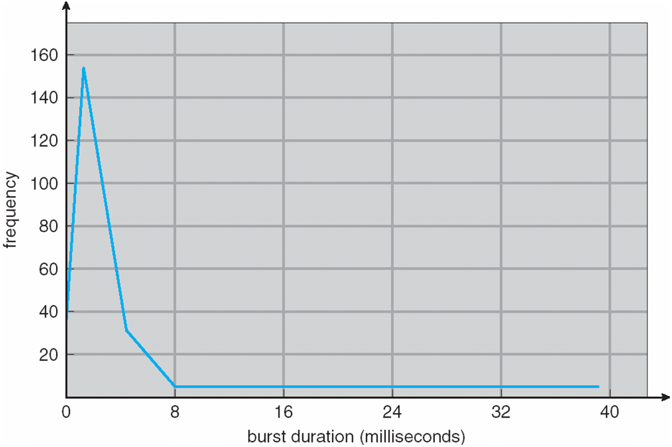
Histogram of CPU-burst Times

Slide 126
CPU Scheduler
Short-term scheduler selects from among the processes in ready queue, and allocates the CPU to one of them
Queue may be ordered in various ways
CPU scheduling decisions may take place when a process:
1. Switches from running to waiting state
2. Switches from running to ready state
3. Switches from waiting to ready
Terminates
Scheduling under 1 and 4 is nonpreemptive
All other scheduling is preemptive
Consider access to shared data
Consider preemption while in kernel mode
Consider interrupts occurring during crucial OS activities

Slide 127
Dispatcher
Dispatcher module gives control of the CPU to the process selected by the short-term scheduler; this involves:
switching context
switching to user mode
jumping to the proper location in the user program to restart that program
Dispatch latency – time it takes for the dispatcher to stop one process and start another running

Slide 128
Scheduling Criteria
CPU utilization – keep the CPU as busy as possible
Throughput – # of processes that complete their execution per time unit
Turnaround time – amount of time to execute a particular process
Waiting time – amount of time a process has been waiting in the ready queue
Response time – amount of time it takes from when a request was submitted until the first response is produced, not output (for time-sharing environment)

Slide 129
Scheduling Algorithm Optimization Criteria
Max CPU utilization
Max throughput
Min turnaround time
Min waiting time
Min response time

Slide 130
First- Come, First-Served (FCFS) Scheduling
Process Burst Time
P₁ 24
P₂ 3
P₃ 3
Suppose that the processes arrive in the order: P₁ , P₂ , P₃ The Gantt Chart for the schedule is:
Waiting time for P₁ = 0; P₂ = 24; P₃ = 27
Average waiting time: (0 + 24 + 27)/3 = 17

Slide 131
FCFS Scheduling (Cont.)
Suppose that the processes arrive in the order:
P₂ , P₃ , P₁
The Gantt chart for the schedule is:
Waiting time for P₁ = 6; P₂ = 0; P₃ = 3
Average waiting time: (6 + 0 + 3)/3 = 3
Much better than previous case
Convoy effect - short process behind long process
Consider one CPU-bound and many I/O-bound processes

Slide 132
Shortest-Job-First (SJF) Scheduling
Associate with each process the length of its next CPU burst
Use these lengths to schedule the process with the shortest time
SJF is optimal – gives minimum average waiting time for a given set of processes
The difficulty is knowing the length of the next CPU request
Could ask the user

Slide 133
Example of SJF
ProcessArriva l Time Burst Time
P₁ 0.0 6
P₂ 2.0 8
P₃ 4.0 7
P₄ 5.0 3
SJF scheduling chart
Average waiting time = (3 + 16 + 9 + 0) / 4 = 7

Slide 134
Determining Length of Next CPU Burst
Can only estimate the length – should be similar to the previous one
Then pick process with shortest predicted next CPU burst
Can be done by using the length of previous CPU bursts, using exponential averaging
Commonly, α set to ½
Preemptive version called shortest-remaining-time-first

Slide 135
Prediction of the Length of the Next CPU Burst

Slide 136
Examples of Exponential Averaging
α =0
τ_{n+1} = τ_{n}
Recent history does not count
α =1
τ_{n+1} = α t_{n}
Only the actual last CPU burst counts
If we expand the formula, we get:
τ_{n+1} = α t_{n}+(1 - α)α t_{n} ₋₁ + …
+(1 - α )^{j} α t_{n} _{-j} + …
+(1 - α )^{n +1} τ₀
Since both α and (1 - α) are less than or equal to 1, each successive term has less weight than its predecessor

Slide 137
Example of Shortest-remaining-time-first
Now we add the concepts of varying arrival times and preemption to the analysis
ProcessA arri Arrival TimeT Burst Time
P₁ 0 8
P₂ 1 4
P₃ 2 9
P₄ 3 5
Preemptive SJF Gantt Chart
Average waiting time = [(10-1)+(1-1)+(17-2)+5-3)]/4 = 26/4 = 6.5 msec

Slide 138
Priority Scheduling
A priority number (integer) is associated with each process
The CPU is allocated to the process with the highest priority (smallest integer ≡ highest priority)
Preemptive
Nonpreemptive
SJF is priority scheduling where priority is the inverse of predicted next CPU burst time
Problem ≡ Starvation – low priority processes may never execute
Solution ≡ Aging – as time progresses increase the priority of the process

Slide 139
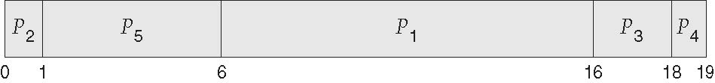
Example of Priority Scheduling
ProcessA arri Burst TimeT Priority
P₁ 10 3
P₂ 1 1
P₃ 2 4
P₄ 1 5
P₅ 5 2
Priority scheduling Gantt Chart
Average waiting time = 8.2 msec

Slide 140
Round Robin (RR)
Each process gets a small unit of CPU time (time quantum q), usually 10-100 milliseconds. After this time has elapsed, the process is preempted and added to the end of the ready queue.
If there are n processes in the ready queue and the time quantum is q, then each process gets 1/n of the CPU time in chunks of at most q time units at once. No process waits more than (n-1)q time units.
Timer interrupts every quantum to schedule next process
Performance
q large ⇒ FIFO
q small ⇒ q must be large with respect to context switch, otherwise overhead is too high

Slide 141
Example of RR with Time Quantum = 4
Process Burst Time
P₁ 24
P₂ 3
P₃ 3
The Gantt chart is:
Typically, higher average turnaround than SJF, but better response
q should be large compared to context switch time
q usually 10ms to 100ms, context switch < 10 usec

Slide 142
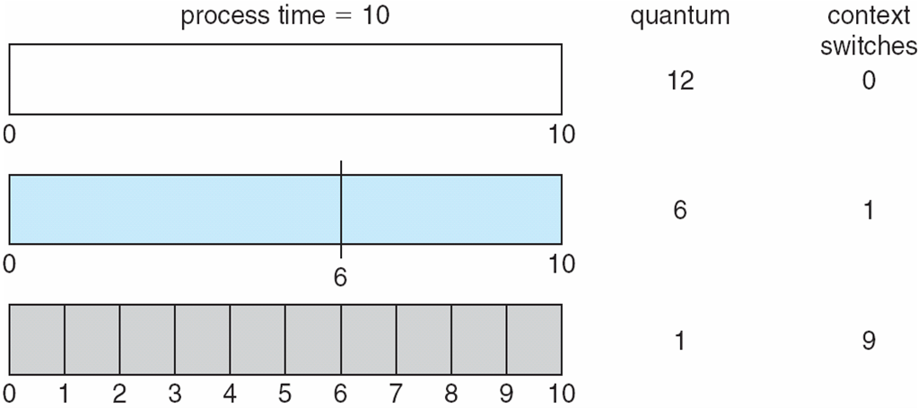
Time Quantum and Context Switch Time

Slide 143
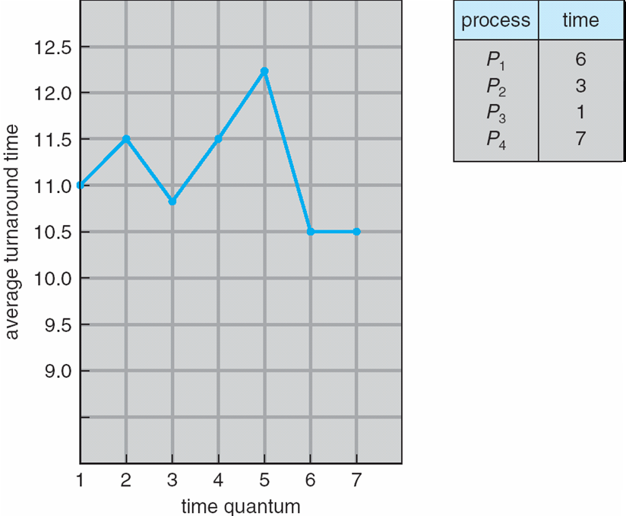
Turnaround Time Varies With The Time Quantum
80% of CPU bursts should be shorter than q

Slide 144
Multilevel Queue
Ready queue is partitioned into separate queues, eg:
foreground (interactive)
background (batch)
Process permanently in a given queue
Each queue has its own scheduling algorithm:
foreground – RR
background – FCFS
Scheduling must be done between the queues:
Fixed priority scheduling; (i.e., serve all from foreground then from background). Possibility of starvation.
Time slice – each queue gets a certain amount of CPU time which it can schedule amongst its processes; i.e., 80% to foreground in RR
20% to background in FCFS

Slide 145
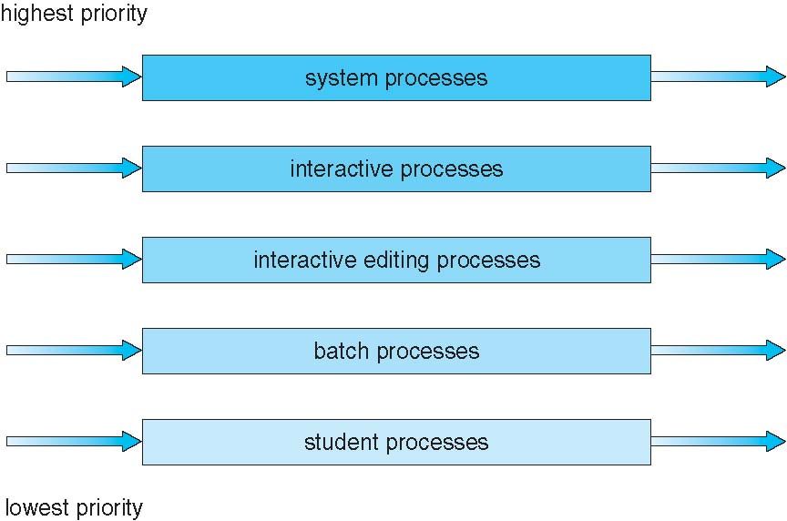
Multilevel Queue Scheduling

Slide 146
Multilevel Feedback Queue
A process can move between the various queues; aging can be implemented this way
Multilevel-feedback-queue scheduler defined by the following parameters:
number of queues
scheduling algorithms for each queue
method used to determine when to upgrade a process
method used to determine when to demote a process
method used to determine which queue a process will enter when that process needs service

Slide 147
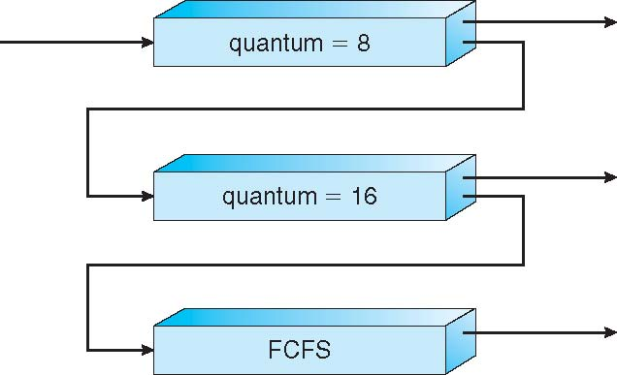
Example of Multilevel Feedback Queue
Three queues:
Q₀ – RR with time quantum 8 milliseconds
Q₁ – RR time quantum 16 milliseconds
Q₂ – FCFS
Scheduling
A new job enters queue Q₀ which is served FCFS
When it gains CPU, job receives 8 milliseconds
If it does not finish in 8 milliseconds, job is moved to queue Q₁
At Q₁ job is again served FCFS and receives 16 additional milliseconds
If it still does not complete, it is preempted and moved to queue Q₂

Slide 148
Thread Scheduling
Distinction between user-level and kernel-level threads
When threads supported, threads scheduled, not processes
Many-to-one and many-to-many models, thread library schedules user-level threads to run on LWP
Known as process-contention scope (PCS) since scheduling competition is within the process
Typically done via priority set by programmer
Kernel thread scheduled onto available CPU is system-contention scope (SCS) – competition among all threads in system

Slide 149
System Model
System consists of resources
Resource types R₁, R₂, . . ., R_{m}
CPU cycles, memory space, I/O devices
Each resource type R_{i} has W_{i} instances.
Each process utilizes a resource as follows:
request
use
release

Slide 150
Deadlock Characterization
Deadlock can arise if four conditions hold simultaneously.
Mutual exclusion: only one process at a time can use a resource
Hold and wait: a process holding at least one resource is waiting to acquire additional resources held by other processes
No preemption: a resource can be released only voluntarily by the process holding it, after that process has completed its task
Circular wait: there exists a set {P₀, P₁, …, P_{n}} of waiting processes such that P₀ is waiting for a resource that is held by P₁, P₁ is waiting for a resource that is held by P₂, …, P_{n–1} is waiting for a resource that is held by P_{n}, and P_{n} is waiting for a resource that is held by P₀.

Slide 151
Deadlock with Mutex Locks
Deadlocks can occur via system calls, locking, etc.

Slide 152
Resource-Allocation Graph
A set of vertices V and a set of edges E.
V is partitioned into two types:
P = {P₁, P₂, …, P_{n}}, the set consisting of all the processes in the system
R = {R₁, R₂, …, R_{m}}, the set consisting of all resource types in the system
request edge – directed edge P_{i} → R_{j}
assignment edge – directed edge R_{j} → P_{i}

Slide 153
Resource-Allocation Graph (Cont.)
Process
Resource Type with 4 instances
P_{i} requests instance of R_{j}
P_{i} is holding an instance of R_{j}
P_{i}
R_{j}
P_{i}
R_{j}

Slide 154
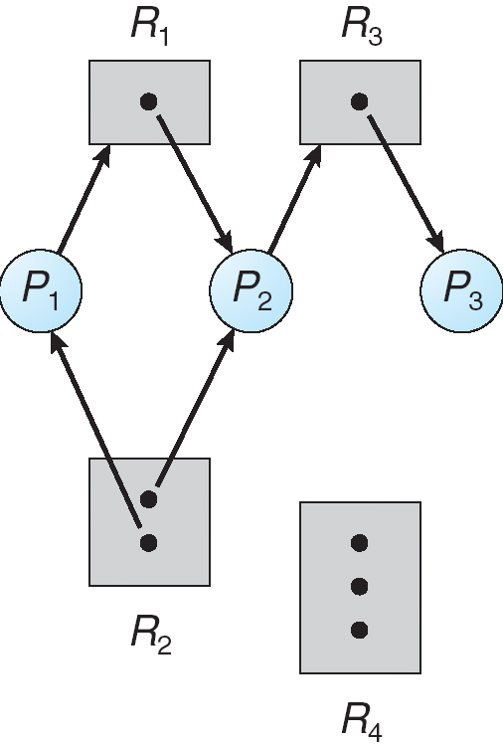
Example of a Resource Allocation Graph

Slide 155
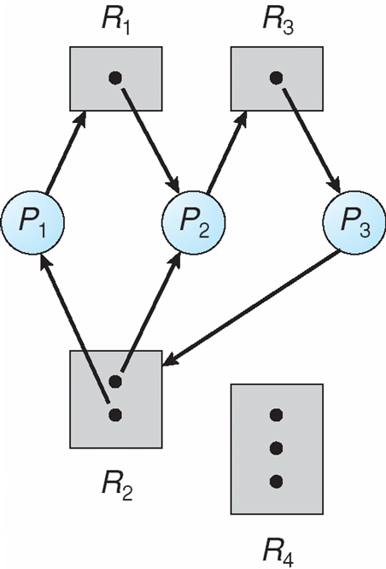
Resource Allocation Graph With A Deadlock

Slide 156
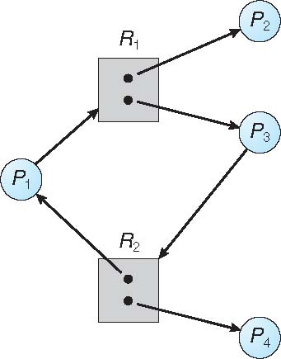
Graph With A Cycle But No Deadlock

Slide 157
Basic Facts
If graph contains no cycles ⇒ no deadlock
If graph contains a cycle ⇒
if only one instance per resource type, then deadlock
if several instances per resource type, possibility of deadlock

Slide 158
Methods for Handling Deadlocks
Ensure that the system will never enter a deadlock state:
Deadlock prevention
Deadlock avoidence
Allow the system to enter a deadlock state and then recover
Ignore the problem and pretend that deadlocks never occur in the system; used by most operating systems, including UNIX

Slide 159
Deadlock Prevention
Restrain the ways request can be made
Mutual Exclusion – not required for sharable resources (e.g., read-only files); must hold for non-sharable resources
Hold and Wait – must guarantee that whenever a process requests a resource, it does not hold any other resources
Require process to request and be allocated all its resources before it begins execution, or allow process to request resources only when the process has none allocated to it.
Low resource utilization; starvation possible

Slide 160
Deadlock Prevention (Cont.)
No Preemption –
If a process that is holding some resources requests another resource that cannot be immediately allocated to it, then all resources currently being held are released
Preempted resources are added to the list of resources for which the process is waiting
Process will be restarted only when it can regain its old resources, as well as the new ones that it is requesting
Circular Wait – impose a total ordering of all resource types, and require that each process requests resources in an increasing order of enumeration

Slide 161
Deadlock Avoidance
Requires that the system has some additional a priori information available
Simplest and most useful model requires that each process declare the maximum number of resources of each type that it may need
The deadlock-avoidance algorithm dynamically examines the resource-allocation state to ensure that there can never be a circular-wait condition
Resource-allocation state is defined by the number of available and allocated resources, and the maximum demands of the processes

Slide 162
Safe State
When a process requests an available resource, system must decide if immediate allocation leaves the system in a safe state
System is in safe state if there exists a sequence <P₁, P₂, …, P_{n}> of ALL the processes in the systems such that for each P_{i}, the resources that P_{i} can still request can be satisfied by currently available resources + resources held by all the P_{j}, with j < I
That is:
If P_{i} resource needs are not immediately available, then P_{i} can wait until all P_{j} have finished
When P_{j} is finished, P_{i} can obtain needed resources, execute, return allocated resources, and terminate
When P_{i} terminates, P_{i +1} can obtain its needed resources, and so on

Slide 163
Basic Facts
If a system is in safe state ⇒ no deadlocks
If a system is in unsafe state ⇒ possibility of deadlock
Avoidance ⇒ ensure that a system will never enter an unsafe state.

Slide 164
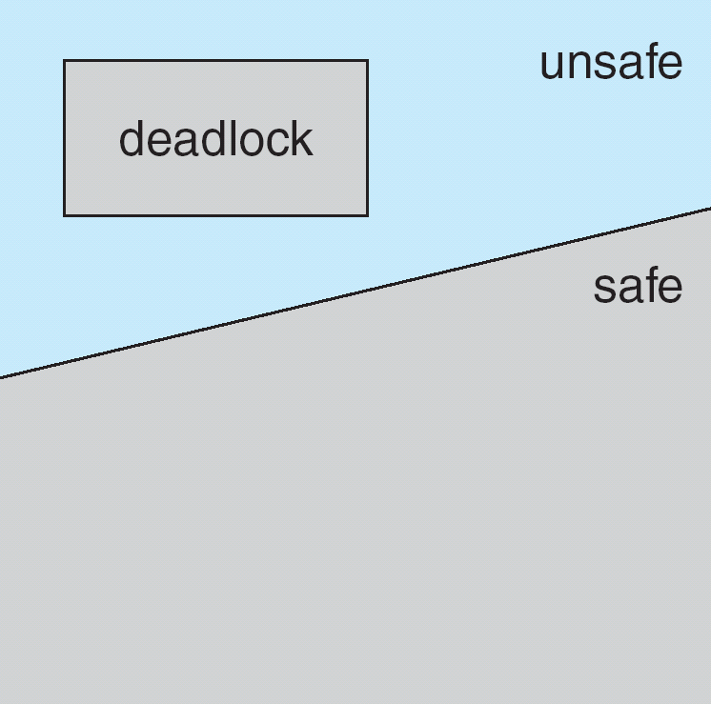
Safe, Unsafe, Deadlock State

Slide 165
Avoidance Algorithms
Single instance of a resource type
Use a resource-allocation graph
Multiple instances of a resource type
Use the banker’s algorithm

Slide 166
Resource-Allocation Graph Scheme
Claim edge P_{i} → R_{j} indicated that process P_{j} may request resource R_{j}; represented by a dashed line
Claim edge converts to request edge when a process requests a resource
Request edge converted to an assignment edge when the resource is allocated to the process
When a resource is released by a process, assignment edge reconverts to a claim edge
Resources must be claimed a priori in the system

Slide 167
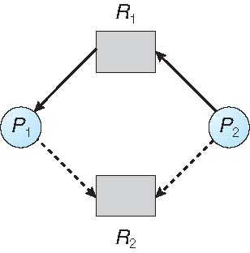
Resource-Allocation Graph

Slide 168
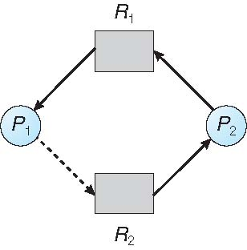
Unsafe State In Resource-Allocation Graph

Slide 169
Resource-Allocation Graph Algorithm
Suppose that process P_{i} requests a resource R_{j}
The request can be granted only if converting the request edge to an assignment edge does not result in the formation of a cycle in the resource allocation graph

Slide 170
Banker’s Algorithm
Multiple instances
Each process must a priori claim maximum use
When a process requests a resource it may have to wait
When a process gets all its resources it must return them in a finite amount of time

Slide 171
Data Structures for the Banker’s Algorithm
Let n = number of processes, and m = number of resources types.
Available: Vector of length m. If available [j] = k, there are k instances of resource type R_{j} available
Max: n x m matrix. If Max [i,j] = k, then process P_{i} may request at most k instances of resource type R_{j}
Allocation: n x m matrix. If Allocation[i,j] = k then P_{i} is currently allocated k instances of R_{j}
Need: n x m matrix. If Need[i,j] = k, then P_{i} may need k more instances of R_{j} to complete its task Need [i,j] = Max[i,j] – Allocation [i,j]

Slide 172
Safety Algorithm
1. Let Work and Finish be vectors of length m and n, respectively. Initialize:
Work = Available
Finish [i] = false for i = 0, 1, …, n- 1
2. Find an i such that both:
(a) Finish [i] = false
(b) Need_{i} ≤ Work
If no such i exists, go to step 4
3. Work = Work + Allocation_{i} Finish[i] = true go to step 2
4. If Finish [i] == true for all i, then the system is in a safe state

Slide 173
Resource-Request Algorithm for Process P_{i}
Request_{i} = request vector for process P_{i}. If Request_{i} [j] = k then process P_{i} wants k instances of resource type R_{j}
1. If Request_{i} ≤ Need_{i} go to step 2. Otherwise, raise error condition, since process has exceeded its maximum claim
2. If Request_{i} ≤ Available, go to step 3. Otherwise P_{i} must wait, since resources are not available
3. Pretend to allocate requested resources to P_{i} by modifying the state as follows:
Available = Available – Request_{i};
Allocation_{i} = Allocation_{i} + Request_{i};
Need_{i} = Need_{i} – Request_{i};
If safe ⇒ the resources are allocated to P_{i}
If unsafe ⇒ P_{i} must wait, and the old resource-allocation state is restored

Slide 174
Example of Banker’s Algorithm
5 processes P₀ through P₄;
3 resource types:
A (10 instances), B (5instances), and C (7 instances)
Snapshot at time T₀:
Allocation Max Available
A B C A B C A B C
P₀ 0 1 0 7 5 3 3 3 2
P₁ 2 0 0 3 2 2
P₂ 3 0 2 9 0 2
P₃ 2 1 1 2 2 2
P₄ 0 0 2 4 3 3

Slide 175
Example (Cont.)
The content of the matrix Need is defined to be Max – Allocation
Need
A B C
P₀ 7 4 3
P₁ 1 2 2
P₂ 6 0 0
P₃ 0 1 1
P₄ 4 3 1
The system is in a safe state since the sequence < P₁, P₃, P₄, P₂, P₀> satisfies safety criteria

Slide 176
Example: P₁ Request (1,0,2)
Check that Request ≤ Available (that is, (1,0,2) ≤ (3,3,2) ⇒ true
Allocation Need Available
A B C A B C A B C
P₀ 0 1 0 7 4 3 2 3 0
P₁ 3 0 2 0 2 0
P₂ 3 0 2 6 0 0
P₃ 2 1 1 0 1 1
P₄ 0 0 2 4 3 1
Executing safety algorithm shows that sequence < P₁, P₃, P₄, P₀, P₂> satisfies safety requirement
Can request for (3,3,0) by P₄ be granted?
Can request for (0,2,0) by P₀ be granted?

Slide 177
Deadlock Detection
Allow system to enter deadlock state
Detection algorithm
Recovery scheme

Slide 178
Single Instance of Each Resource Type
Maintain wait-for graph
Nodes are processes
P_{i} → P_{j} if P_{i} is waiting for P_{j}
Periodically invoke an algorithm that searches for a cycle in the graph. If there is a cycle, there exists a deadlock
An algorithm to detect a cycle in a graph requires an order of n² operations, where n is the number of vertices in the graph

Slide 179
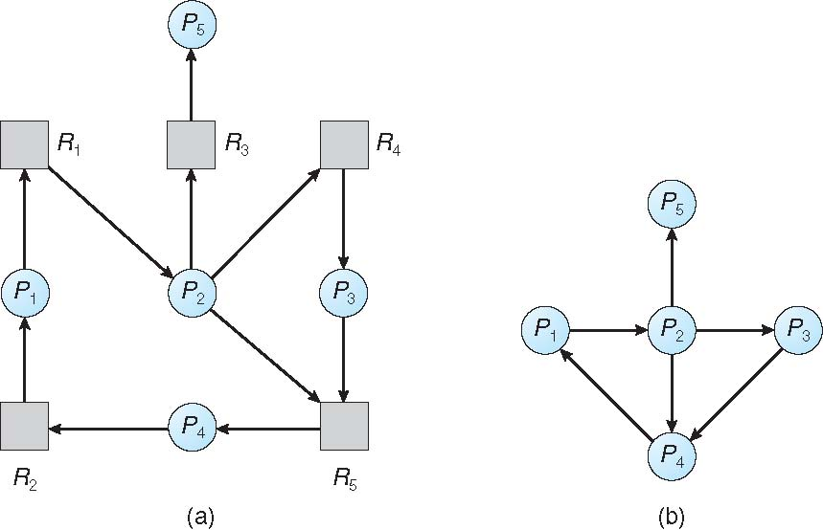
Resource-Allocation Graph and Wait-for Graph
Resource-Allocation Graph
Corresponding wait-for graph

Slide 180
Several Instances of a Resource Type
Available: A vector of length m indicates the number of available resources of each type
Allocation: An n x m matrix defines the number of resources of each type currently allocated to each process
Request: An n x m matrix indicates the current request of each process. If Request [i][j] = k, then process P_{i} is requesting k more instances of resource type R_{j}.

Slide 181
Detection Algorithm
1. Let Work and Finish be vectors of length m and n, respectively Initialize:
(a) Work = Available
(b) For i = 1,2, …, n, if Allocation_{i} ≠ 0, then Finish[i] = false; otherwise, Finish[i] = true
2. Find an index i such that both:
(a) Finish[i] == false
(b) Request_{i} ≤ Work
If no such i exists, go to step 4

Slide 182
Detection Algorithm (Cont.)
3. Work = Work + Allocation_{i} Finish[i] = true go to step 2
4. If Finish[i] == false, for some i, 1 ≤ i ≤ n, then the system is in deadlock state. Moreover, if Finish[i] == false, then P_{i} is deadlocked
Algorithm requires an order of O(m x n²) operations to detect whether the system is in deadlocked state

Slide 183
Example of Detection Algorithm
Five processes P₀ through P₄; three resource types A (7 instances), B (2 instances), and C (6 instances)
Snapshot at time T₀:
Allocation Request Available
A B C A B C A B C
P₀ 0 1 0 0 0 0 0 0 0
P₁ 2 0 0 2 0 2
P₂ 3 0 3 0 0 0
P₃ 2 1 1 1 0 0
P₄ 0 0 2 0 0 2
Sequence <P₀, P₂, P₃, P₁, P₄> will result in Finish[i] = true for all i

Slide 184
Example (Cont.)
P₂ requests an additional instance of type C
Request
A B C
P₀ 0 0 0
P₁ 2 0 2
P₂ 0 0 1
P₃ 1 0 0
P₄ 0 0 2
State of system?
Can reclaim resources held by process P₀, but insufficient resources to fulfill other processes; requests
Deadlock exists, consisting of processes P₁, P₂, P₃, and P₄

Slide 185
Detection-Algorithm Usage
When, and how often, to invoke depends on:
How often a deadlock is likely to occur?
How many processes will need to be rolled back?
one for each disjoint cycle
If detection algorithm is invoked arbitrarily, there may be many cycles in the resource graph and so we would not be able to tell which of the many deadlocked processes “caused” the deadlock.

Slide 186
Recovery from Deadlock: Process Termination
Abort all deadlocked processes
Abort one process at a time until the deadlock cycle is eliminated
In which order should we choose to abort?
Priority of the process
How long process has computed, and how much longer to completion
Resources the process has used
Resources process needs to complete
How many processes will need to be terminated
Is process interactive or batch?

Slide 187
Recovery from Deadlock: Resource Preemption
Selecting a victim – minimize cost
Rollback – return to some safe state, restart process for that state
Starvation – same process may always be picked as victim, include number of rollback in cost factor

Slide 188
Sources and Acknowledgement
Operating System Concepts, Ninth Edition, Avi Silberschatz, Peter Baer Galvin and Greg Gagne. Link: https://www.os-book.com/OS9/slide-dir/index.html

